Slide 1
Evaluating Optimization Algorithms on Flow Network
Ben Heinze

Slide 2
I-90
19th
Lincoln St
28
8
Belgrade
40
13
4
S
College St
5
t
MSU
20
Jackrabbit Ln.
13
30
Huffine

Slide 3
Flow Networks Applications
Finding Bottlenecks in Traffic
Airline Scheduling Optimization
Business Supply Chain Optimization
Image Segmentation in Computer Vision

Slide 4
Three Algorithms
CPLEX (Linear Program Solver)
Ford-Fulkerson (DFS)
Edmonds-Karp (BFS)

Slide 5
Algorithms

Slide 6
Ford-Fulkerson
Start with no flow throughout the network
Find augmenting path from s to t in residual graph
Fill path with the bottleneck flow
Update residual graph
Repeat until no s-t paths exists in residual graph

Slide 7
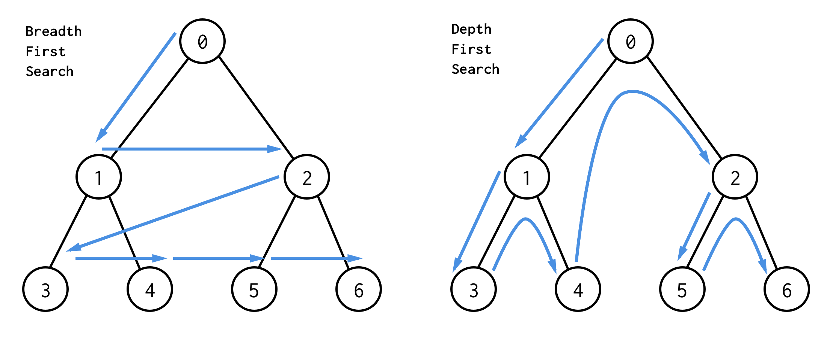
Ford-Fulkerson vs Edmonds-Karp

Slide 8
CPLEX - Linear Program Solver
Decision Variables
Objective
Constraints

Slide 9
CPLEX - Linear Program Solver
Decision Variables:
How much flow to put through each edge
Objective
Maximize flow going into sink t
Constraints:
Flow cannot be greater than capacity
Conservation of flow

Slide 10
Methodology

Slide 11
Graph Generation
Create an integer array 0 to n-1, then shuffle
Reassign int 0 to index 0, then int n-1 to index n-1
Create an edge between the adjacent integers while randomly generating a capacity in range (1, 20)
Create random edges in the graph until density threshold d is met:

Slide 12
Experiment
5 trials for each combination of n and d. Algorithms are timed in milliseconds.

Slide 13
Results

Slide 14
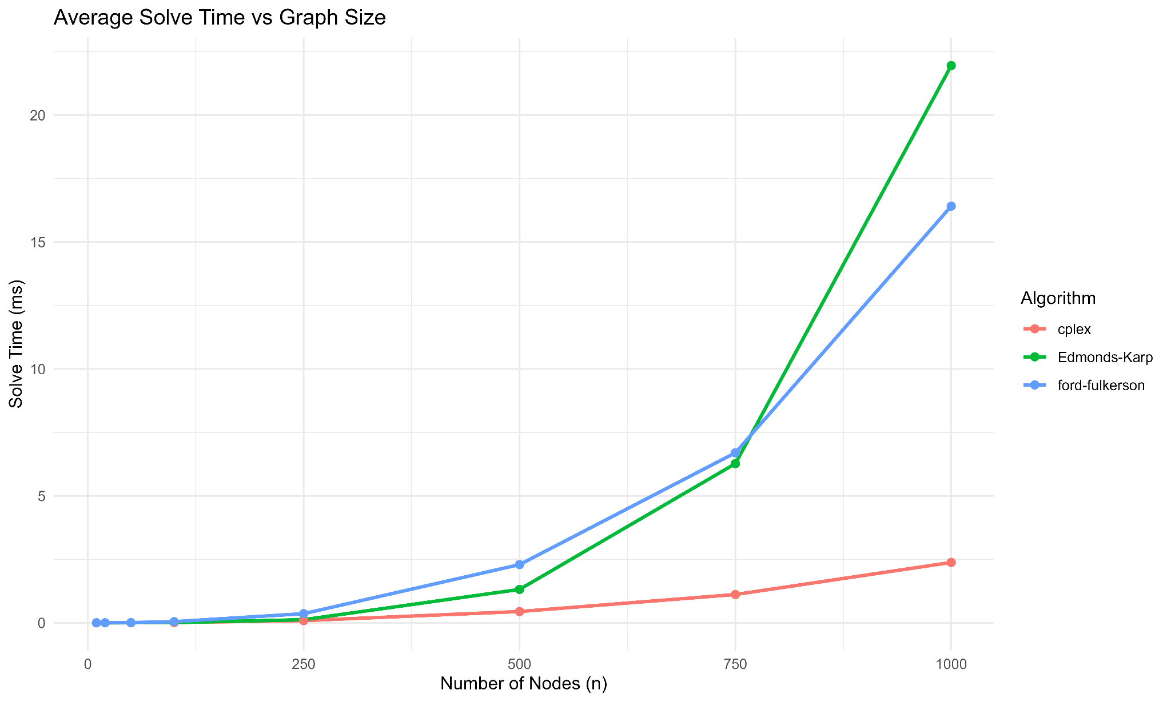

Slide 15
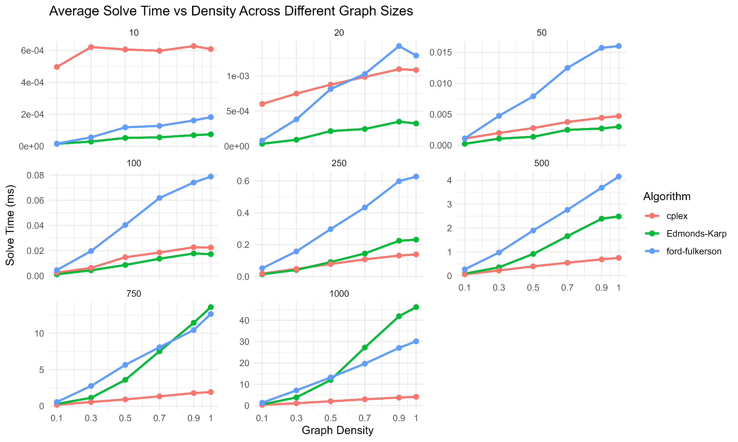

Slide 16
Conclusion

Slide 17
Conclusion
“Never bet against CPLEX” - Sean Yaw

